Slide 2
Azure API Center and ASP.NET Web API Integration: A Developer's Guide
Julia Kasper

Slide 3

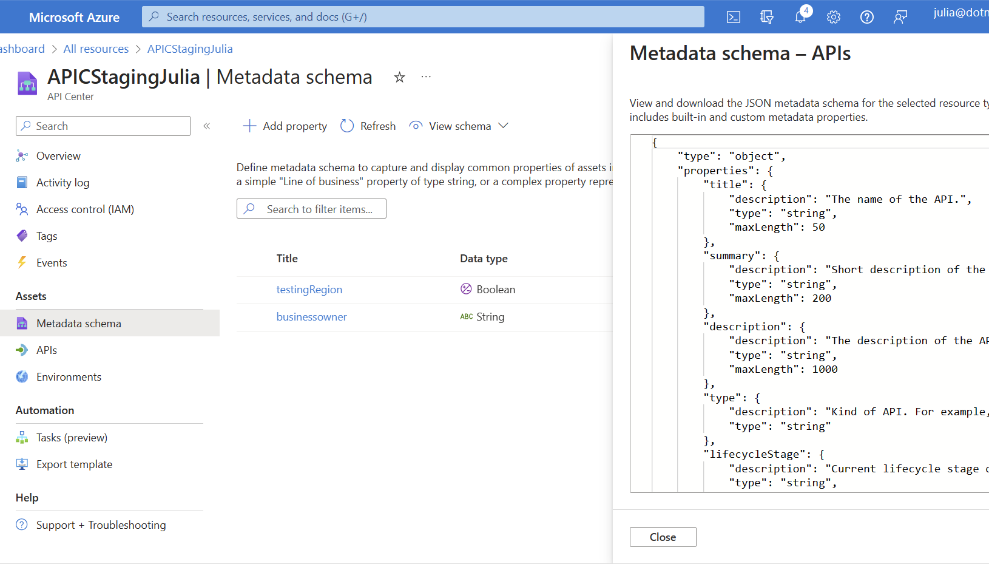
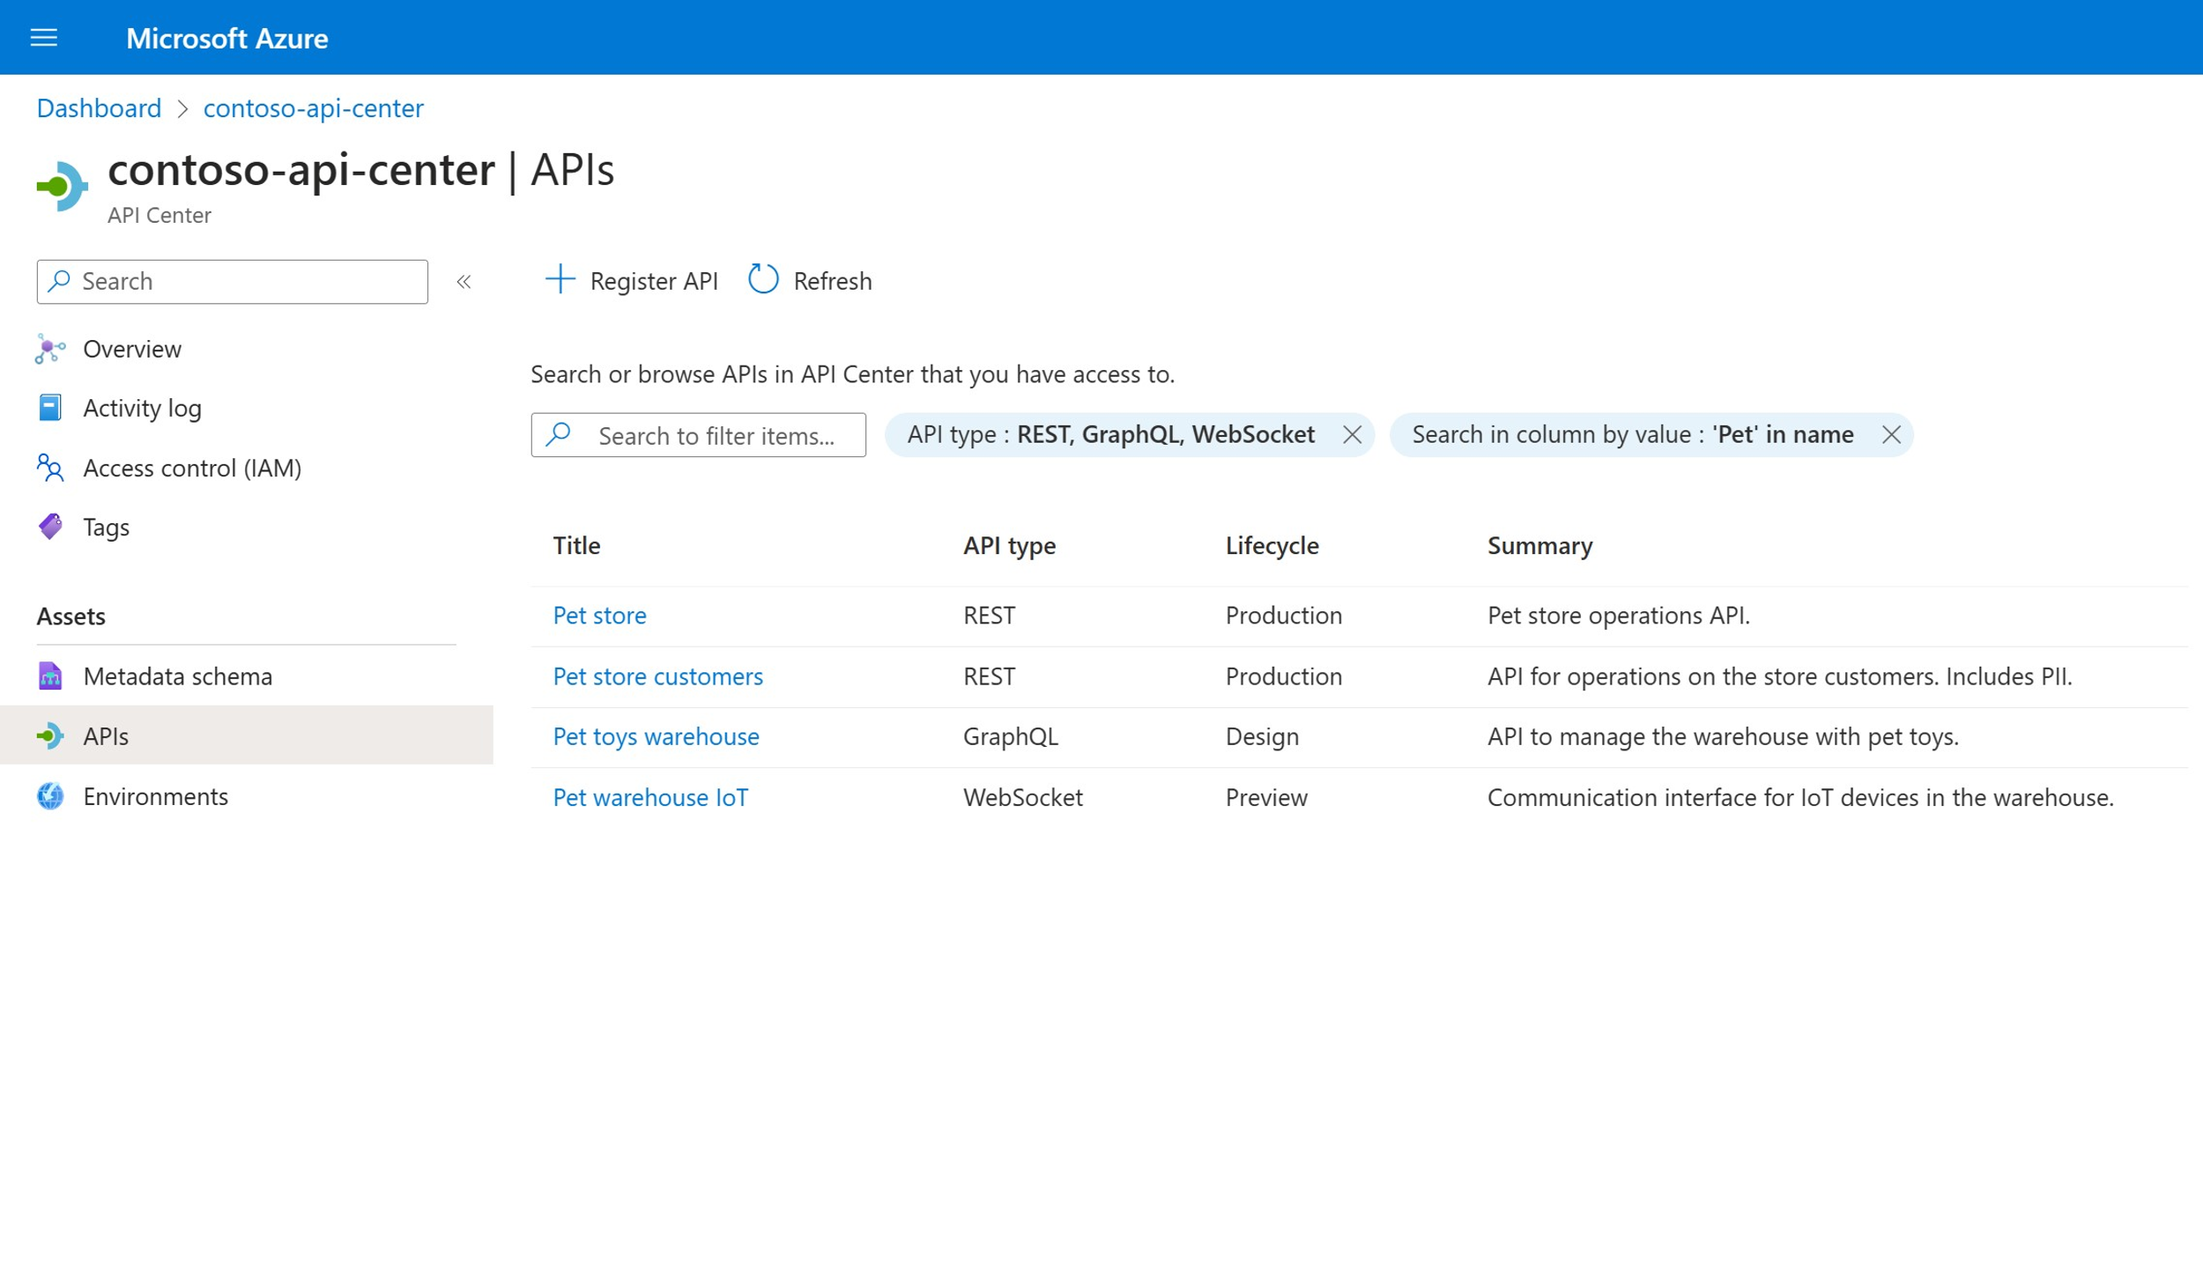

Create an organizational API hub with Azure API Center Now in public preview – Azure API Center
Create and maintain an organizational inventory
Organizations can build a complete inventory of APIs available in their organization. Foster collaboration and let API program managers and developers collaborate for increased API reuse, quality, security, compliance, and developer productivity.
Govern organization’s APIs With more complete visibility into the APIs being produced and used within an organization, API program managers and IT administrators can govern this inventory to ensure it meets organizational standards by defining custom metadata and build workflows around this metadata to enforce governance.
Easy API discovery Organizations want to promote API reuse to maximize developer productivity and ensure developers are using the right APIs. API program managers and developers can discover the API inventory via the Azure portal, API Portal, and other developer tools like VS Code.

Slide 4












Azure API Center is at the center of your API ecosystems
API developers
App developers API developers API Program Managers
Design and develop
CLI
VS Code
API Center Portal
Custom portals (e.g., Backstage)
VS Code
Visual Studio
Organize and manage inventory at scale
Implement, monitor, and enforce design-time compliance
Monitor non-design-time compliance (e.g., security, privacy)
Discover and
consume
Push
API Center
Populate
APIs, versions, deployments
API definitions
Metadata
RBAC
Azure DevOps
CLI
GitHub
Populate
Implement runtime governance
3rd party API management solutions
Unmanaged APIs
Azure API Management
Deploy
API Program Managers

Slide 5
Demo

Slide 6


Timeline
Public Preview
Nov 23
Jan 24
General Availability
Registering APIs via Azure Portal
Import APIs from APIM via CLI
Registering APIs via Azure CLI
APIC portal launched for search and discovery of APIs
Registering APIs via GitHub Actions
Registering APIs via Azure Pipelines
Registering APIs from Apigee
View API operations details’, subscribe to Azure APIM APIs and test console in dev portal
Visual Studio Code Extension
Enable API dev portal administration experience
Discover and consume your APIs from Apigee and non-Azure environments through the dev portal
Backstage/WordPress plugin for dev portal
Sep 23
Oct 23
Nov 23
Dec 23
Jan 24
Feb 24
Mar 24
Oct 23
Dec 23
Feb 24
“Quick Add” functionality in Azure Portal for API specs and API URLs
APIC developer portal provides download specification, export to Postman functionality
Build custom governance workflows with Logic Apps (e.g., email notifications, alerting, approval flows)

Slide 7

Resources
Documentation Azure API Center https://learn.microsoft.com/en-us/azure/api-center/overview
Set up an Azure API Center https://learn.microsoft.com/en-us/azure/api-center/set-up-api-center
Provide Feedback https://github.com/Azure/api-center-preview/issues
Recent Blog Posts https://aka.ms/apic/apim https://aka.ms/apic/cli

Slide 8
Download .NET 8
https://aka.ms/get-dotnet-8

